Slide 1
Drug Treatment Courts
The Fundamentals
Justice Kofi Barnes kofi.barnes@scj-csj.ca

Slide 2
The problem
Drug addicted offenders are caught in the revolving door of drug use/addiction and criminal behavior to support a drug habit.

Slide 3
ROOT CAUSES

Slide 4
An innovative approach
Create a strong partnership between legal case processing and substance abuse treatment - establish a Drug Treatment Court (DTC)

Slide 5
Eligibility

Slide 6
Who is eligible?
Almost all Canada’s DTCs are adult programs
Metro West Toronto accepts youth

Slide 7
Who is eligible ?
Adults:
Non violent offender
addiction to cocaine, crack cocaine, opiates, ecstasy/crystal methamphetamine
Alcohol as a subsidiary or accompanying addiction

Slide 8
Who is eligible?
Youth: (Metro West Toronto)
Abuse of illicit drugs
Addiction to all illicit drugs

Slide 9
Eligible offences
Low level drug offence
Low level non drug offence
No or low violence
Addiction must be the primary cause or a significant contributor to criminal behaviour

Slide 10
DENIAL

Slide 11
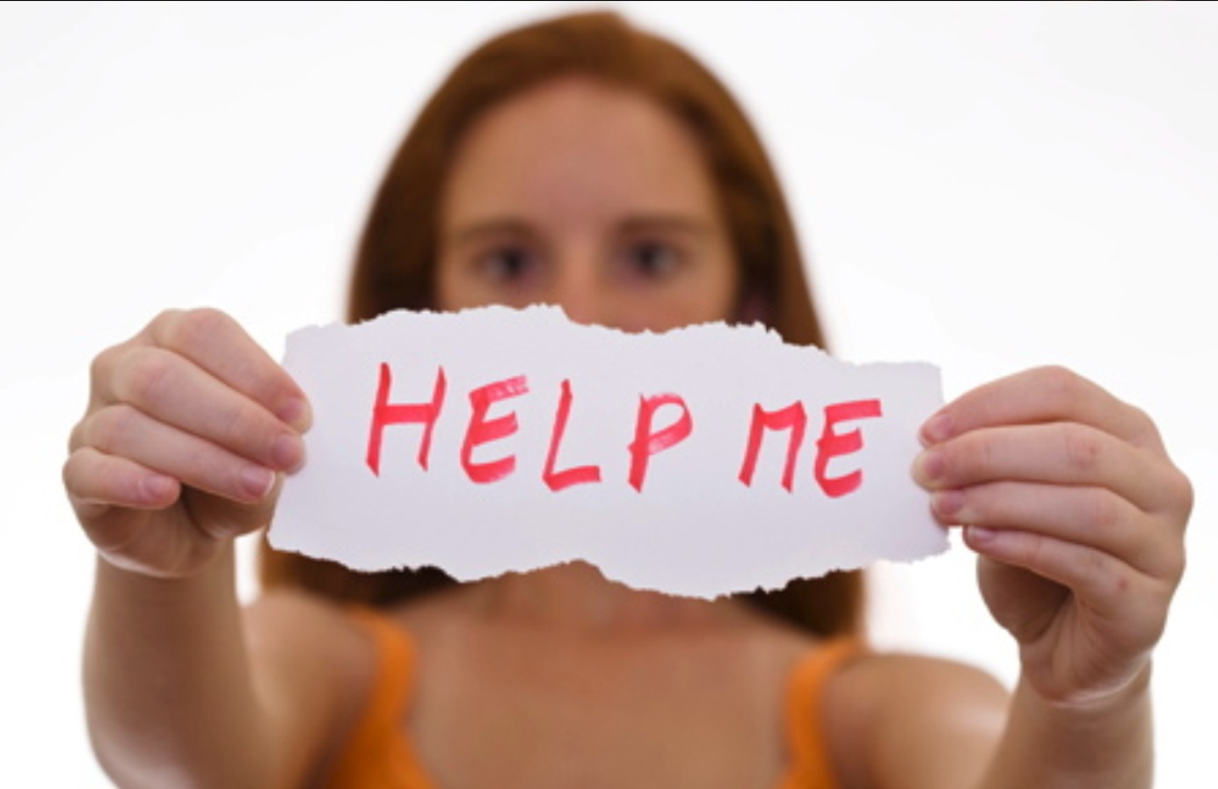

Slide 12
COMPREHENSIVE ASSESSMENT

Slide 13
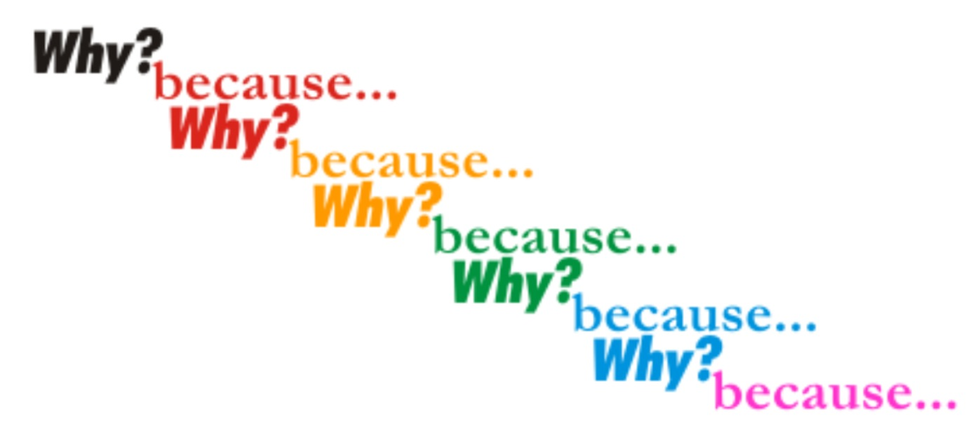

Slide 14
WHY?
ASSESSMENT:
DRUG INVOLVEMENT
MEDICAL ISSUES
PSYCHIATRIC STATUS
EMPLOYMENT AND FINANCIAL STATUS
FAMILY AND SOCIAL STATUS

Slide 15
WHY?
TRIGGERS
SELF ESTEEM
MOTIVATION FOR CHANGE
“AVOID ONE SHOE FITS ALL” APPROACH

Slide 16
TEAM APPROACH

Slide 17
HOLISTIC

Slide 18
Partners
Partners:
Addiction Treatment Services
Mental Health Services (Durham and Metro West Toronto)
Legal Aid
Court
Participant

Slide 19
Partners
Probation
Ministry of the Attorney General
Office of Director of Public Prosecutions
Police
Community Partners e.g. job training, housing etc.

Slide 20
COMMUNITY PARTNERSHIPS

Slide 21
CASE MANAGEMENT

Slide 22
“ONE ON ONE”
JUDICIAL
INTERACTION
INFORMATION
SHARING

Slide 23
TESTING
FERQUENT
RANDOM
URINE SCREENS

Slide 24
Fundamental Expectations
Honesty
Accountability
Focus is on compliance with program requirements

Slide 25
Fundamental Expectations
Immediate abstinence is not expected
A series of “smart” therapeutically based sanctions and incentives are utilized to ensure compliance and positive behavior modification
Abstinence is a requirement for graduation from the program

Slide 26
SANCTIONS AND INCENTIVES

Slide 27
General Graduation Criteria

Slide 28
Some Graduation Criteria
A period of complete abstinence from “drug of choice” for example, 4 months.
A period of complete abstinence from other drugs (including alcohol) for example, 1 month.
Some DTCs require abstinence from all illicit drugs

Slide 29
FACES

Slide 30
Some Graduation Criteria
Stable and appropriate housing.
Full time employment or attendance at school.
Appropriate lifestyle changes.

Slide 31
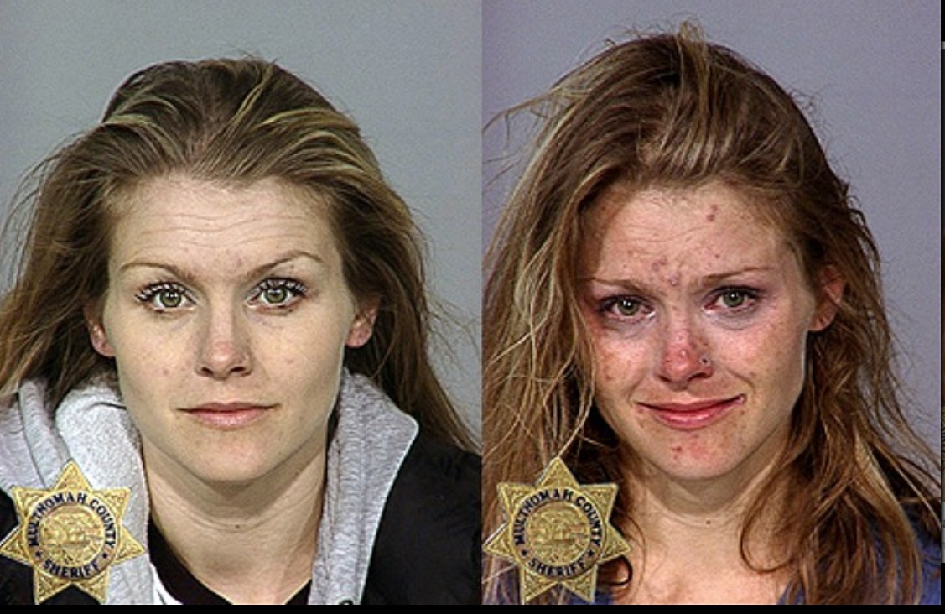

Slide 32
The Final Disposition
DTC “graduates ” receive non custodial sentences
The sentences imposed usually include a probation order which incorporates conditions designed to encourage and facilitate participation in After Care programs

Slide 33
Other measures of “success”
“Substantial compliance”
Significantly decreased drug use.
Increased social stability.
Acquisition of tools that may assist later in life.
Notes:
“Substantial compliance”: two or three people so far, compared with ~90 graduates: compliant with all requirements of graduation except abstinence from cannabis; receive non-custodial sentence, but no formal graduation ceremony or graduate status.
Benefits acquired short of graduation:
Even though I got expelled from the program, it changed my life a lot. I don’t go to jail nowadays. I keep my apartment. It’s been one year and almost four months I been living in the same place. So I kind of straightened up my life.[1] [1] Toronto Drug Treatment Court Evaluation Project Final Report, supra, page 135.

