Slide 1
Drug Treatment Courts
The Canadian Legal Framework –
an outline
Justice Kofi Barnes kofi.barnes@scj-csj.ca

Slide 2
ROOT CAUSES

Slide 3
The problem
Drug addicted offenders are caught in the revolving door of drug use/addiction and criminal behavior to support a drug habit.

Slide 4
An innovative approach
Create a strong partnership between legal case processing and substance abuse treatment - establish a Drug Treatment Court (DTC)

Slide 5
Treatment Model
Most Canadian DTC programs utilize non residential treatment programs
Residential programs are utilized when required
Calgary DTC is the exception – primary focus is residential treatment

Slide 6
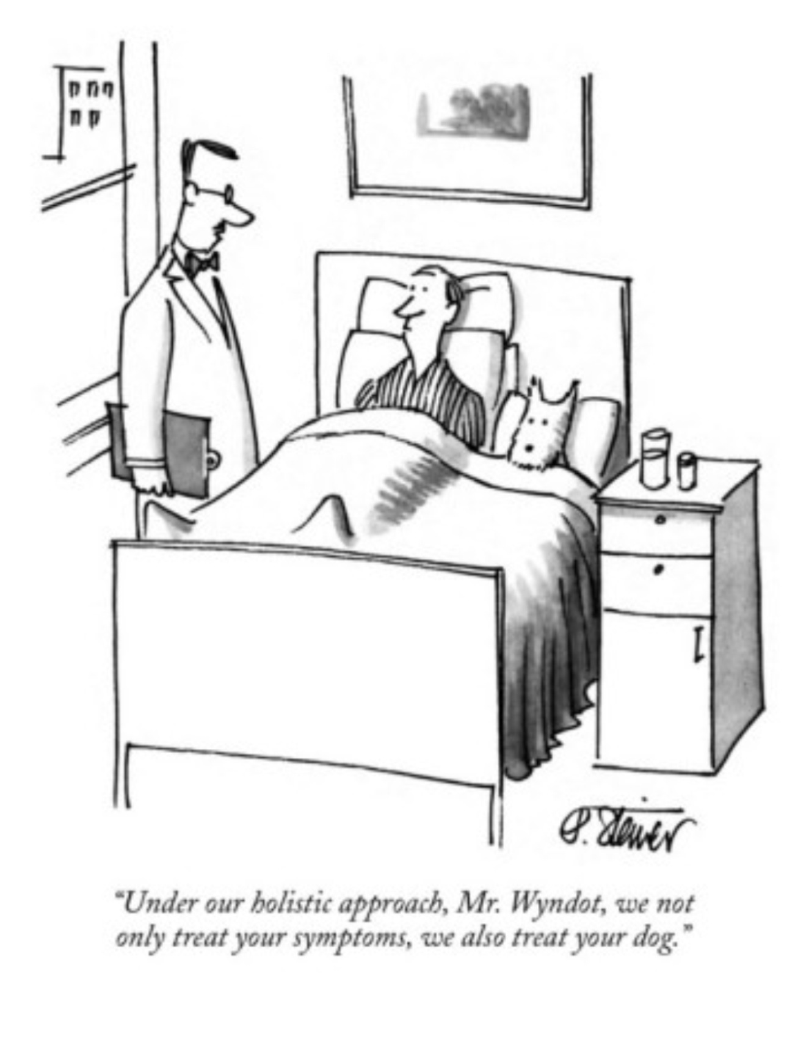

Slide 7
Partners
Partners:
Addiction Treatment Services
Mental Health Services (Durham and Metro West Toronto)
Legal Aid
Court
Participant

Slide 8
Partners
Probation
Ministry of the Attorney General
Office of Director of Public Prosecutions
Police
Community Partners e.g. job training, housing etc.

Slide 9
Who is eligible?
Almost all Canada’s DTCs are adult programs
Metro West Community Restoration Court (accepts youth)

Slide 10
Who is eligible ?
Adults:
Non violent offender
addiction to cocaine, crack cocaine, opiates, ecstasy/crystal methamphetamine
Alcohol as a subsidiary or accompanying addiction

Slide 11
Who is eligible?
Youth: (Metro West Toronto)
Abuse of illicit drugs
Addiction to all illicit drugs

Slide 12
Modes of Participation
Pre Plea (pre adjudication) – no plea is entered. Charges are typically with drawn after program completion.
Pre Plea mode is rarely used for adults in Canada
Pre Plea mode frequently utilised for youth

Slide 13
Modes of Participation
Pre Plea participants, in effect, agree to waive their section 11(b) Charter right to a trial within a reasonable time

Slide 14
Modes of Participation
Post Plea (post adjudication) – a guilty plea is entered. Participant receives a non custodial sentence upon program completion.
Post Plea mode is the typical mode of participation for adults in Canada

Slide 15
The Legislative Framework
There is no legislation in Canada defining a Drug Treatment Court Program or describing what the key components of a Drug Treatment Court should be.

Slide 16
The Legislative Framework
There are provisions in the Criminal Code and the Controlled Drugs and Substances Act that facilitate the operation of a Drug Treatment Court in Canada

Slide 17
Criminal Code
Section 720 (2) of the Criminal Code allows a the court to delay sentencing for an accused to attend a treatment program approved by the province such as a Drug Treatment Court

Slide 18
CDSA
Section 10 (4) (a) of the Controlled Drugs and Substances Act allows a the court to delay sentencing for an accused to attend a Drug Treatment Court Program approved by the province.

Slide 19
Criminal Code
s. 515- bail provisions
bail conditions are tailored to meet key Drug Treatment Court program components

Slide 20
Criminal Code
S732.1(3)(h) – for creative conditions
s.732.2(3) – allows for early termination of probation
S742.4(1) and 742.4(5)- for changes to optional conditions of a conditional sentence order

Slide 21
13 Key Components
A Court is a Drug Treatment Court when it adheres to 13 internationally recognised principles

Slide 22
Components 1 to 4
Marriage of Treatment Services with the Court
Non-adversarial Approach to Decisions
Eligible Offenders are Identified Early
Treatment Services

Slide 23
Components 5 to 9
Urine Testing
Incentives and Sanctions
Ongoing Judicial Supervision
Evaluation
Interdisciplinary Training

Slide 24
Components 10 to 13
Partnerships with the Community
The importance of Case Management
Program me Must be Flexible
Planning for After -care

Slide 25
The 13 Key Components
Drug Treatment Court bail conditions and Rule and Waiver Agreements(Forms) enable Drug Treatment Courts to implement these principles

Slide 26
Rule and Waiver Form
A Rule and Waiver form describes program expectations and is signed by the participants after receiving independent legal advice.

Slide 27
Eligible offences
Low level drug offence
Low level non drug offence
No or low violence
Addiction must be the primary cause or a significant contributor to criminal behaviour

Slide 28
DTC Process
No specific legislation for DTC
Program designed to fit in existing legislative framework – Criminal Code
Program specific rules and expectations encompassed by “Rule and Waiver” Forms and bail conditions

Slide 29
DTC process
Participant must obtain independent legal advice
All applicable legal rights/issues and program expectations and rules contained in Rule and Waiver Form
Participant must sign Rule and Waiver Form

Slide 30
DTC Process
Post Plea (post adjudication):
Guilty plea - sentencing delayed
Non custodial sentence imposed upon completion
Common for both adult and youth

Slide 31
DTC Process
Pre–Plea (Pre adjudication):
Charges withdrawn on completion
Common for youth
Rare for adults - insufficient interest

Slide 32
DTC Process
Arrest
Drug Treatment Court Application
Screening by Crown
Preliminary Assessment by Treatment Provider

Slide 33
DTC Process
Group Assessment (Case conference/Pre trial)
Rule and Waiver Form signed
In court interview by Judge
Release on bail for further assessment by the treatment provider

Slide 34
DTC Process
Return to Court
Eligible persons enter the program
An assessment period to determine suitability for program (usually 30 days)

Slide 35
DTC Process
Program duration an average of 12 months
Non custodial sentence is imposed on graduation

